Slide 1


Slide 2
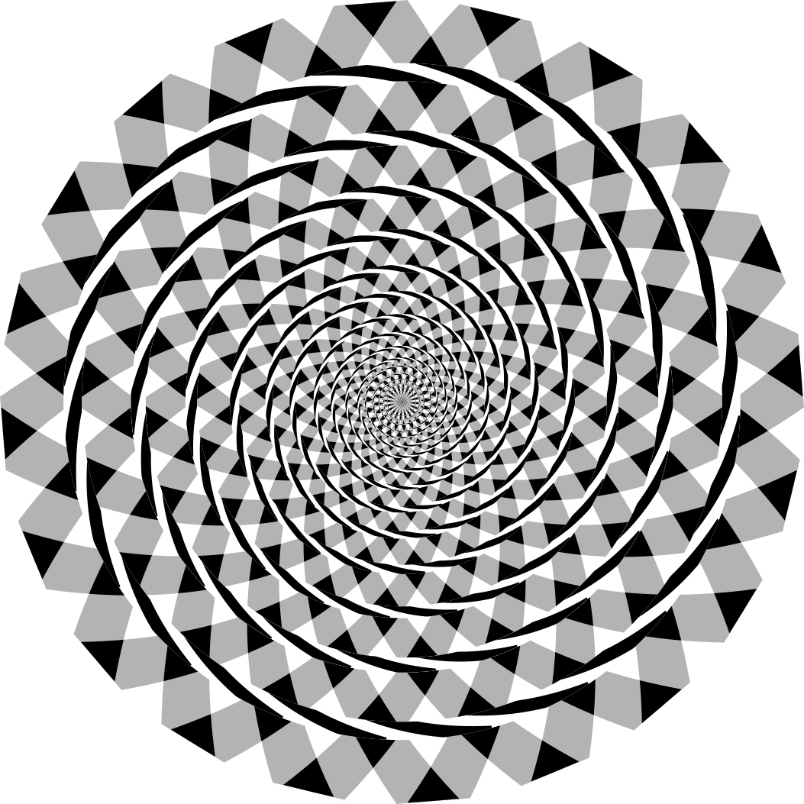
Wikipedia - Mysid
Notes:
Frasier Spiral Illusion
https://en.wikipedia.org/wiki/Fraser_spiral_illusion
Author is Mysid

Slide 3
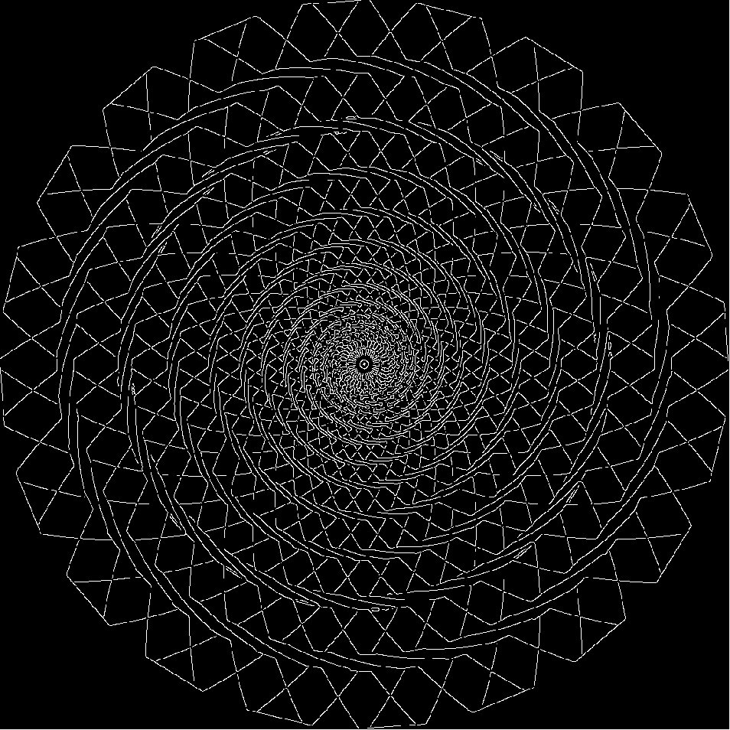
Notes:
Canny sigma default (sqrt(2))

Slide 4
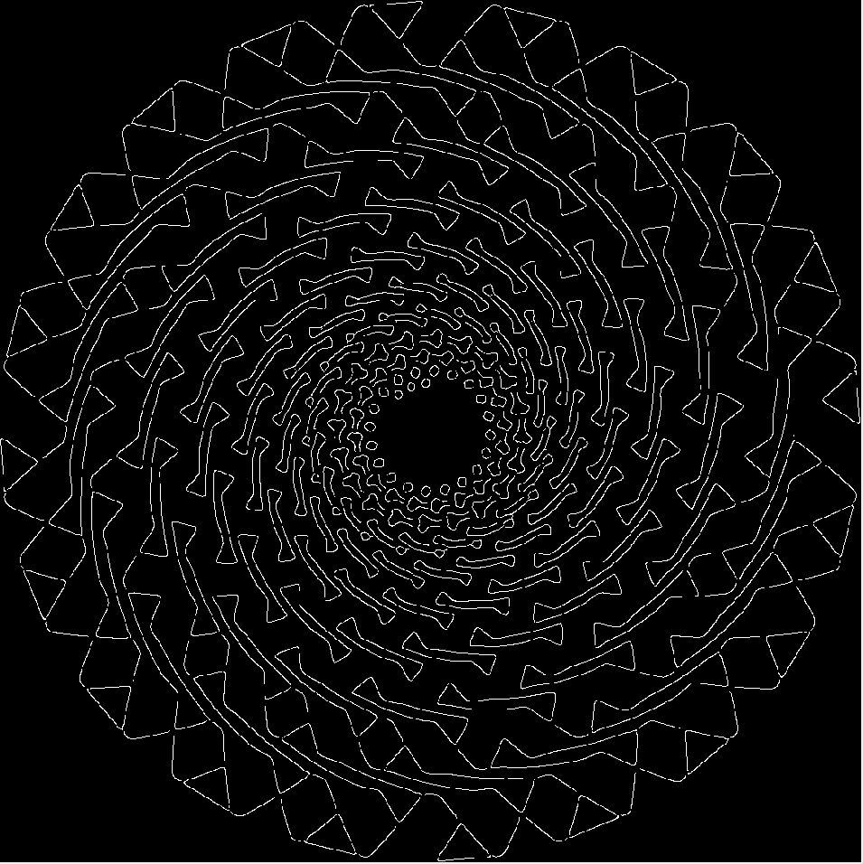
Notes:
Sigma 4

Slide 5
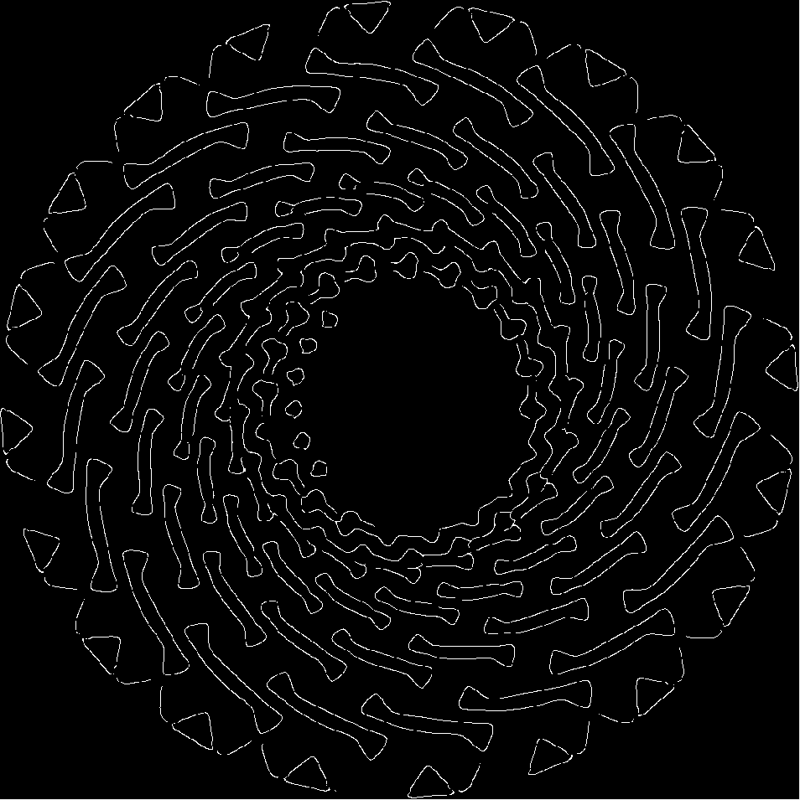
Notes:
Sigma 8

Slide 6
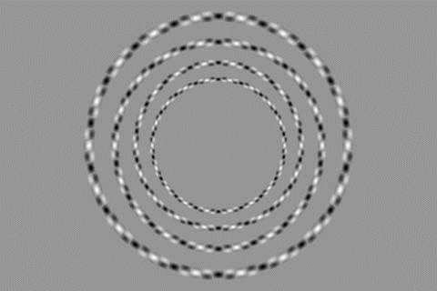

Slide 7
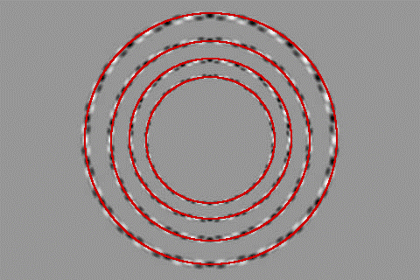

Slide 8
Corners
Filtering
Edges
Feature points
Also called interest points, key points, etc. Often described as ‘local’ features.
Szeliski 4.1
Slides from Rick Szeliski, Svetlana Lazebnik, Derek Hoiem and Grauman&Leibe 2008 AAAI Tutorial

Slide 9
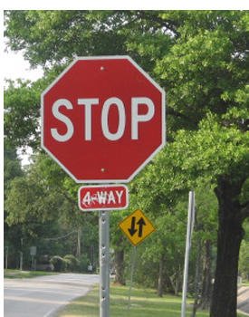


Correspondence across views
Correspondence: matching points, patches, edges, or regions across images.
≈
Hays

Slide 10
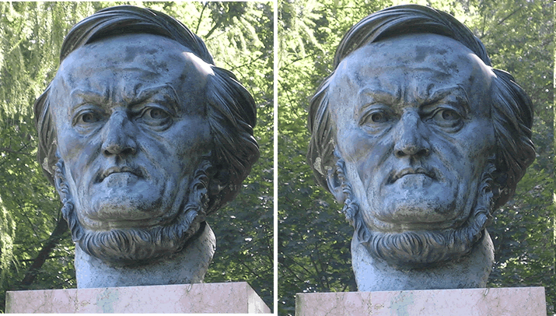
Example: estimate “fundamental matrix” that corresponds two views
Silvio Savarese

Slide 11
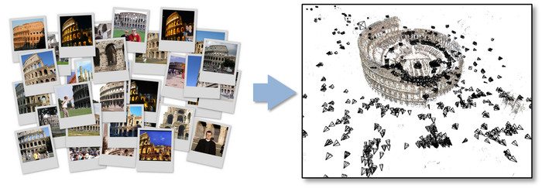
Example: structure from motion

Slide 12
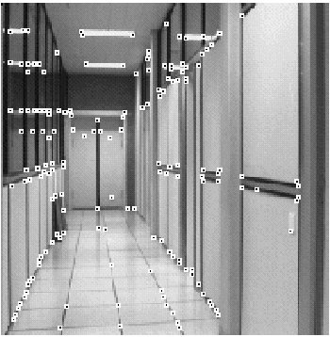
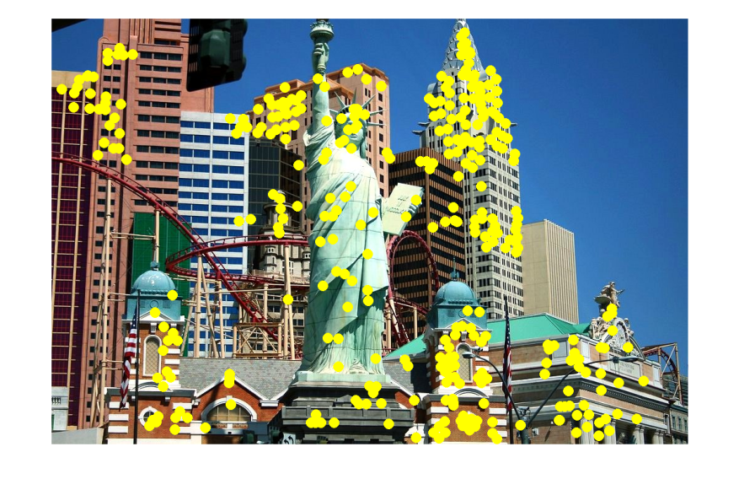
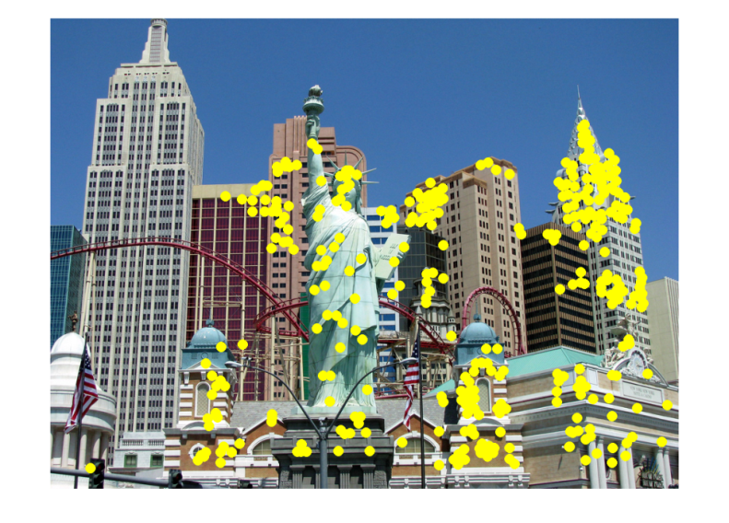
Fundamental to Applications
Feature points are used for:
Image alignment
3D reconstruction
Motion tracking (robots, drones, AR)
Indexing and database retrieval
Object recognition
…
Hays

Slide 13
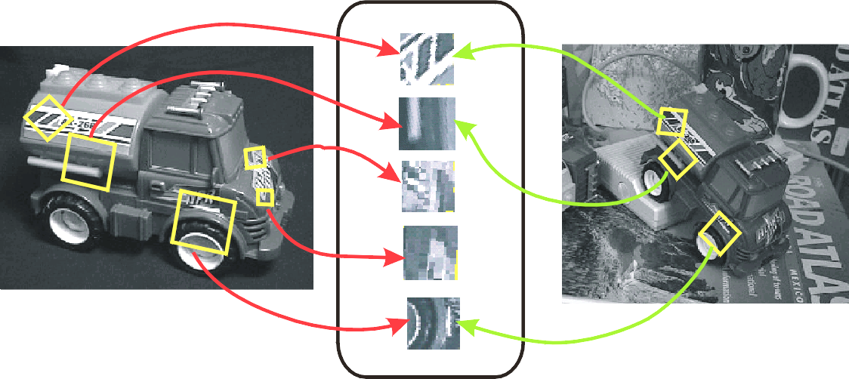
Example: Invariant Local Features
Detect points that are repeatable and distinctive.
I.E., invariant to image transformations:
appearance variation (brightness, illumination)
geometric variation (translation, rotation, scale).
Keypoint Descriptors
James Hays

Slide 14


Example application
Panorama stitching
We have two images – how do we combine them?

Slide 15


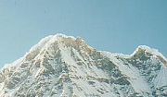
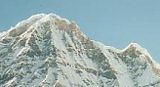
Local features: main components
Detection: Find a set of distinctive key points.
Description: Extract feature descriptor around each interest point as vector.
Matching: Compute distance between feature vectors to find correspondence.

Slide 16
Characteristics of good features
Repeatability
The same feature can be found in several images despite geometric and photometric transformations
Saliency
Each feature is distinctive
Compactness and efficiency
Many fewer features than image pixels
Locality
A feature occupies a relatively small area of the image; robust to clutter and occlusion
Kristen Grauman

Slide 17
Goal: interest operator repeatability
We want to detect (at least some of) the same points in both images.
Yet we have to be able to run the detection procedure independently per image.
With these points, there’s no chance to find true matches!
Kristen Grauman

Slide 18
Goal: descriptor distinctiveness
We want to be able to reliably determine which point goes with which.
Must provide some invariance to geometric and photometric differences between the two views.
?
Kristen Grauman

Slide 19
Local features: main components
Detection: Find a set of distinctive key points.
Description: Extract feature descriptor around each interest point as vector.
Matching: Compute distance between feature vectors to find correspondence.

Slide 20
Detection: Basic Idea
We do not know which other image locations the feature will end up being matched against.
But we can compute how stable a location is in appearance with respect to small variations in position u.
Compare image patch against local neighbors.
A. Efros

Slide 21

Corner Detection: Basic Idea
We might recognize the point by looking through a small window.
We want a window shift in any direction to give a large change in intensity.
“Flat” region: no change in all directions
“Edge”: no change along the edge direction
“Corner”: significant change in all directions
A. Efros

Slide 22
Corner Detection by Auto-correlation
Change in appearance of window w(x,y) for shift [u,v]:
Window function
Shifted intensity
Intensity
Window function w(x,y) =
or
1 in window, 0 outside
Gaussian
Source: R. Szeliski

Slide 23
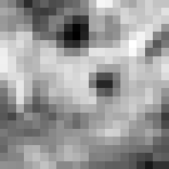

Corner Detection by Auto-correlation
Change in appearance of window w(x,y) for shift [u,v]:
I(x, y)
E(u, v)
E(0,0)
w(x, y)

Slide 24
Corner Detection by Auto-correlation
Change in appearance of window w(x,y) for shift [u,v]:
I(x, y)
E(u, v)
E(3,2)
w(x, y)

Slide 25
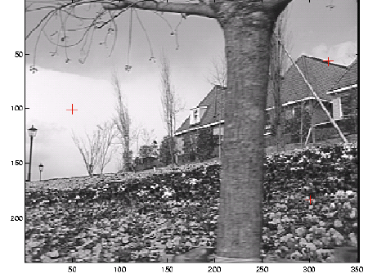
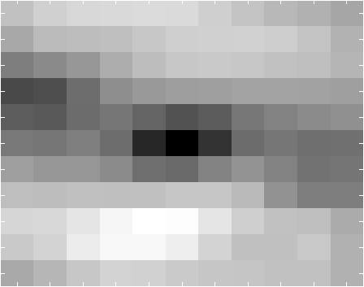
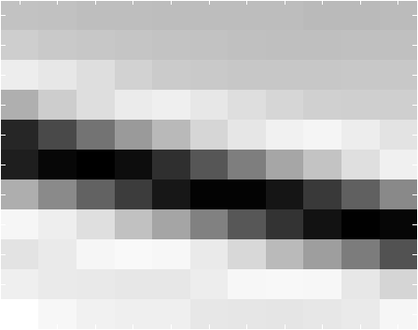
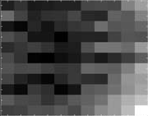
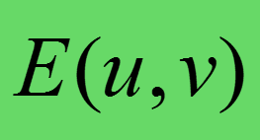
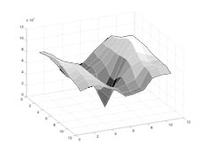
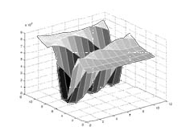
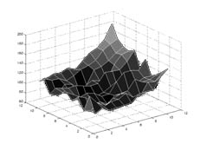
Think-Pair-Share:
Correspond the three red crosses to (b,c,d).
As a surface
Notes:
Figure 4.5 Three auto-correlation surfaces EAC(u) shown as both grayscale images and surface plots:
The original image is marked with three red crosses to denote where the auto-correlation surfaces were computed;
this patch is from the flower bed (good unique minimum);
this patch is from the roof edge (one-dimensional aperture problem); and
this patch is from the cloud (no good peak).
Each grid point in figures b–d is one value of u.

Slide 26
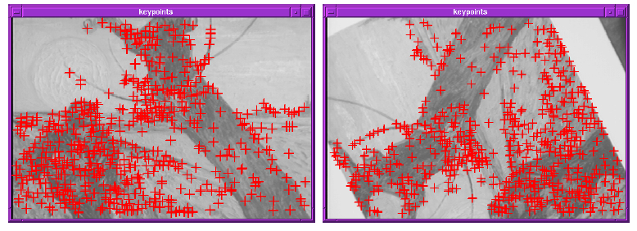
Finding Corners
Key property: in the region around a corner, image gradient has two or more dominant directions
Corners are repeatable and distinctive
C.Harris and M.Stephens. "A Combined Corner and Edge Detector.“ Proceedings of the 4th Alvey Vision Conference: pages 147--151.

Slide 27
Corner Detection by Auto-correlation
Change in appearance of window w(x,y) for shift [u,v]:
We want to discover how E behaves for small shifts
But this is very slow to compute naively.
O(window_width² * shift_range² * image_width²)
O( 11² * 11² * 600² ) = 5.2 billion of these
14.6 thousand per pixel in your image

Slide 28
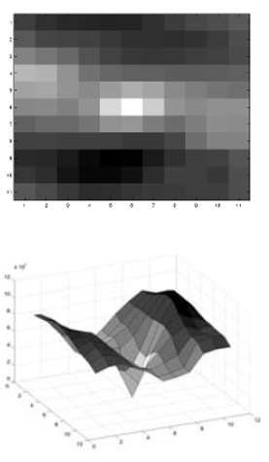
Corner Detection by Auto-correlation
Change in appearance of window w(x,y) for shift [u,v]:
We want to discover how E behaves for small shifts
But we know the response in E that we are looking for – strong peak.

Slide 29
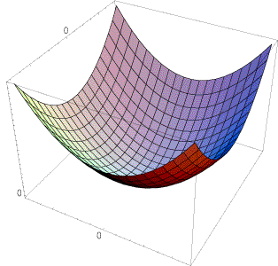
Can we just approximate E(u,v) locally by a quadratic surface?
≈

Slide 30
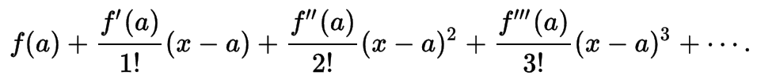
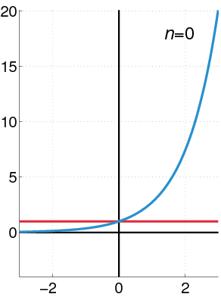
Recall: Taylor series expansion
A function f can be represented by an infinite series of its derivatives at a single point a:
Wikipedia
As we care about window centered, we set a = 0
(MacLaurin series)
Approximation of f(x) = e^{x} centered at f(0)

Slide 31
Local quadratic approximation of E(u,v) in the neighborhood of (0,0) is given by the second-order Taylor expansion:
Notation: partial derivative
Notes:
Technically a Maclaurin expansion, a special case of Taylor expansion centered at 0.
What is the point? Well, now we’re just extrapolating local measurements instead of doing 10s of thousands of computations.

Slide 32
Local quadratic approximation of E(u,v) in the neighborhood of (0,0) is given by the second-order Taylor expansion:
Ignore function value; set to 0
Ignore first derivative, set to 0
Just look at shape of second derivative
Notes:
Technically a Maclaurin expansion, a special case of Taylor expansion centered at 0.
What is the point? Well, now we’re just extrapolating local measurements instead of doing 10s of thousands of computations.

Slide 33
Corner Detection: Mathematics
Second-order Taylor expansion of E(u,v) about (0,0):

Slide 34
Corner Detection: Mathematics
Second-order Taylor expansion of E(u,v) about (0,0):

Slide 35
Corner Detection: Mathematics
Second-order Taylor expansion of E(u,v) about (0,0):

Slide 36
Corner Detection: Mathematics
The quadratic approximation simplifies to
where M is a second moment matrix computed from image derivatives:
M
Notes:
https://en.wikipedia.org/wiki/Image_moment

Slide 37
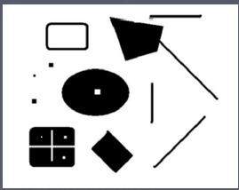
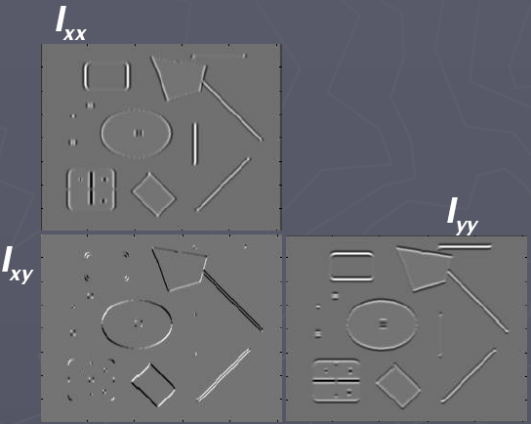
Corners as distinctive interest points
2 x 2 matrix of image derivatives (averaged in neighborhood of a point)
Notation:
James Hays

Slide 38
Interpreting the second moment matrix
The surface E(u,v) is locally approximated by a quadratic form. Let’s try to understand its shape.
James Hays

Slide 39
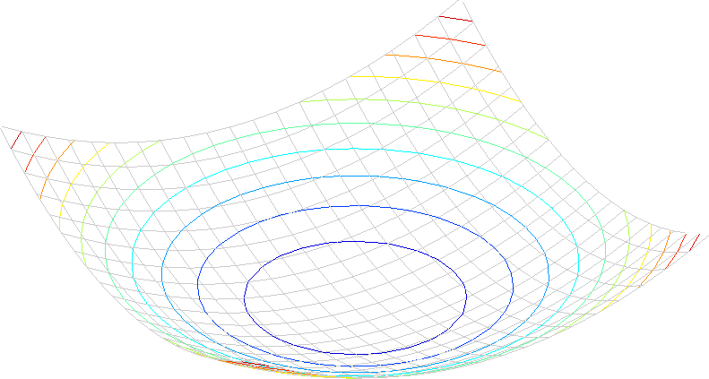
Interpreting the second moment matrix
Consider a horizontal “slice” of E(u, v):
This is the equation of an ellipse.
James Hays
Notes:
Try to implement Harris using the technique expressed on slide 5 of the 'Local Image Features' session.
The ellipse construct is useful for understanding what M represents.
In this case, we are saying that each time c is a constant, we define an ellipse over (an idealized) E.
E is a small matrix that contains values for the local auto-correlation of an image. Its axes are u,v (the shifts in x and y) - e.g., slide 42 in the 'Interest Points and Corners' session.
E contains a set of values, from 0 (no difference in the image patches) up to the maximal difference (one all black, one all white patch, which is 255 square).
We can 'cut' E at different values in this set, to produce different shapes. E.G., if we imagine E as a 3D valley or hole shape, the shape at c = 20 will be a contour around the valley at a constant 'altitiude'.
Now, when we approximate E using the second-order Taylor approximation, we are idealizing the shape that E takes. This is what we see on slide 59 of the 'Interest Points and Corners' session. Here, our 'idealized' E is a smooth surface which approximates the auto-correlation differences, for which cross sections are ellipses. Each of the isolines on slide 59 represents a different cut at a constant value, or a different ellipse.

Slide 40
Interpreting the second moment matrix
First, consider the axis-aligned case (gradients are either horizontal or vertical)
If either λ is close to 0, then this is not a corner, so look for locations where both are large.

Slide 41
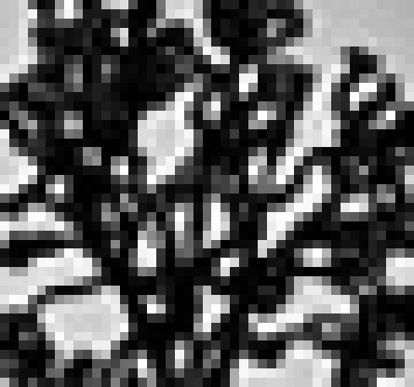
Visualization of second moment matrices
James Hays

Slide 42
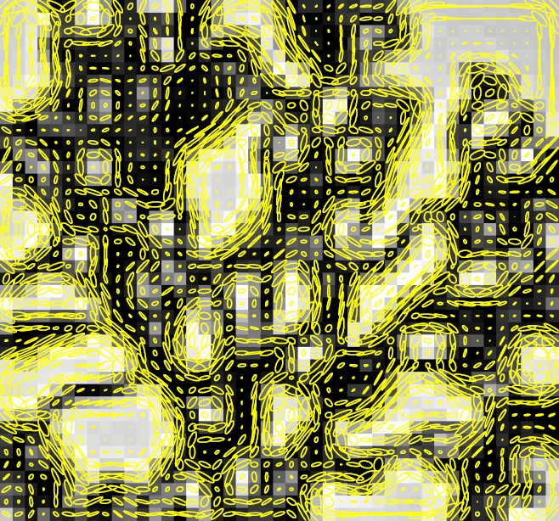
Visualization of second moment matrices
James Hays

Slide 43

Interpreting the second moment matrix
Consider a horizontal “slice” of E(u, v):
This is the equation of an ellipse.
Diagonalization of M:
The axis lengths of the ellipse are determined by the eigenvalues,
and the orientation is determined by a rotation matrix $R$.
direction of the fastest change
direction of the slowest change
(λ_{max})^{-1/2}
(λ_{min})^{-1/2}
James Hays

Slide 44
Classification of image points using eigenvalues of M
λ₂
“Edge” λ₂ >> λ₁
“Corner” λ₁ and λ₂ are large, λ₁ ~ λ₂; E increases in all directions
λ₁ and λ₂ are small; E is almost constant in all directions
“Flat” region
“Edge” λ₁ >> λ₂
λ₁

Slide 45
Classification of image points using eigenvalues of M
Cornerness
λ₂
“Edge” C < 0
“Corner” C > 0
α: constant (0.04 to 0.06)
|C| small
“Flat” region
“Edge” C < 0
λ₁

Slide 46
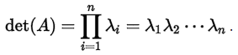
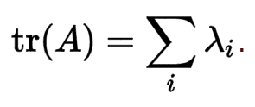
Classification of image points using eigenvalues of M
Cornerness
λ₂
“Edge” C < 0
“Corner” C > 0
α: constant (0.04 to 0.06)
Remember your linear algebra:
Determinant:
Trace:
|C| small
“Flat” region
“Edge” C < 0
λ₁

Slide 47
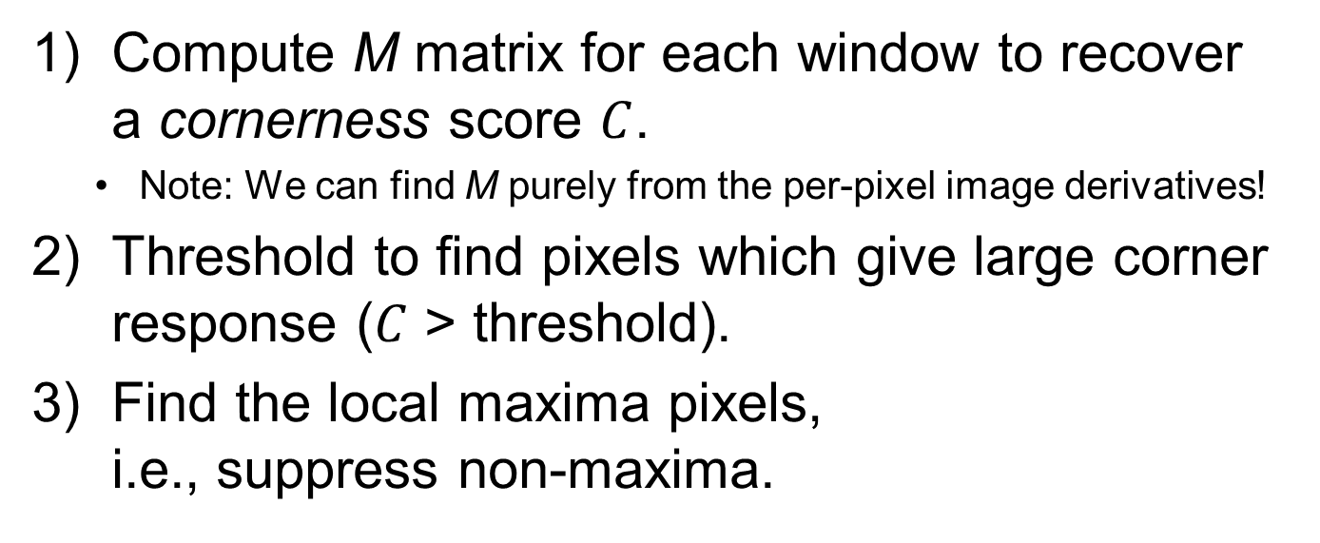
Harris corner detector
Compute M matrix for each window to recover a cornerness score $C$.
Note: We can find M purely from the per-pixel image derivatives!
Threshold to find pixels which give large corner response ($C$ > threshold).
Find the local maxima pixels, i.e., suppress non-maxima.
C.Harris and M.Stephens. “A Combined Corner and Edge Detector.” Proceedings of the 4th Alvey Vision Conference: pages 147—151, 1988.

Slide 48
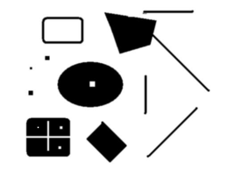
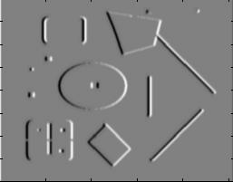
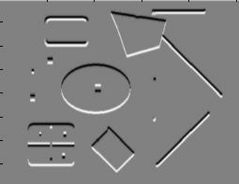
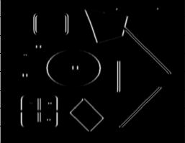
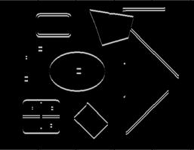
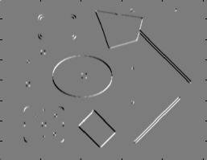
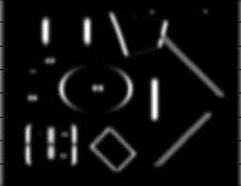
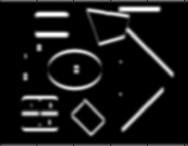
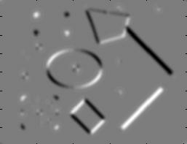
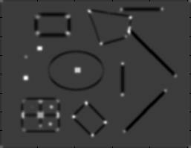


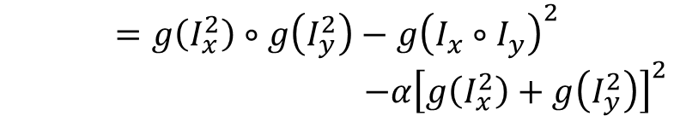
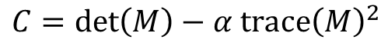



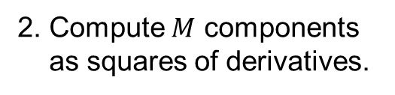






Harris Corner Detector [Harris88]
James Hays
0. Input image We want to compute M at each pixel.
$$I$$
1. Compute image derivatives (optionally, blur first).
$$Ix$$
$$Iy$$
2. Compute $M$ components
as squares of derivatives.
$$I_{x}^{2}$$
$$I_{y}^{2}$$
$$Ixy$$
3. Gaussian filter g() with width σ
$$g(Ix2)$$
$$g(Iy2)$$
$$g(Ix∘Iy)$$
4. Compute cornerness
$$C=\det\left(M\right)−α trace{\left(M\right)}^{2}$$
$$=g\left(I_{x}^{2}\right)∘g\left(I_{y}^{2}\right)−g{\left(I_{x}∘I_{y}\right)}^{2}$$
$−α{\left[g\left(I_{x}^{2}\right)+g\left(I_{y}^{2}\right)\right]}^{2}$
$$R$$
5. Threshold on $C$ to pick high cornerness
6. Non-maxima suppression to pick peaks.
Notes:
$∘$ = https://en.wikipedia.org/wiki/Hadamard_product_(matrices)

Slide 49

Harris Detector: Steps

Slide 50


Harris Detector: Steps
Compute corner response $C$

Slide 51

Harris Detector: Steps
Find points with large corner response: $C$ > threshold

Slide 52


Harris Detector: Steps
Take only the points of local maxima of $C$

Slide 53

Harris Detector: Steps

Slide 54
Invariance and covariance
Are locations invariant to photometric transformations
and covariant to geometric transformations?
Invariance: image is transformed and corner locations do not change
Covariance: if we have two transformed versions of the same image, features should be detected in corresponding locations

